Slide 1
What is ‘Doctorateness’?
Colleen Aldous – 12 May, 2021

Slide 2


Slide 3
Implicit, Tacit, or Explicit:
All Knowledge Is Valuable
Explicit knowledge: knowledge that is easy to articulate, write down, and share
Implicit knowledge: the application of explicit knowledge
Tacit knowledge: knowledge gained from personal experience www.bloomfire.com

Slide 4
In a nutshell… academic progress is…
Learn academic and research skills at honours (get the basics, focus on explicit knowledge gain)
Focus on bringing them together in a small research project to develop competence in masters (gain mastery, focus on implicit knowledge gain)
Exhibit competence in novel research (become expert, focus on tacit knowledge gain)

Slide 5
Three nb documents in SA
NQF/SAQA (2008)
ASSAF Report (2010)
CHE (2018)

Slide 6
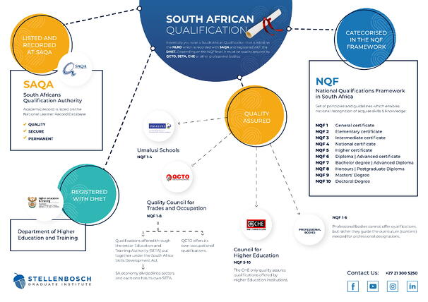
Accreditation and Quality Assurance in Education
https://www.sgi.co.za/blog/accreditation-quality-assurance-faq

Slide 7
NQF and SAQA??
The South African Qualifications Authority (SAQA) oversees the implementation of the National Qualifications Framework (NQF). The NQF system is a set of principles and guidelines which classifies a person’s skills and knowledge according to a certain level. This is recognized nationally in South Africa.
It comprises ten levels of learning achievements.

Slide 8

SAQA Level descriptors

Slide 9
Doctorate
Masters
Honours/MbChB
Bachelors
Matric

Slide 10
NQF level descriptors
• Scope of knowledge
• Knowledge literacy
• Method and procedure
• Problem solving
• Ethics and professional practice
• Accessing, processing and managing information
• Producing and communicating of information
• Context and systems
• Management of learning
• Accountability.

Slide 11
SAQA-NQF Level descriptors
Descriptor | Matric Level 4 | Honours/MBChB Level 8 | Masters Level 9 | Doctorate Level 10
Scope of knowledge | is able to demonstrate a fundamental knowledge base of the most important areas of one or more fields or disciplines, in addition to the fundamental areas of study, and a fundamental understanding of the key terms, rules, concepts, established principles and theories in one or more fields or disciplines. | is able to demonstrate knowledge of and engagement in an area at the forefront of a field, discipline or practice; an understanding of the theories, research methodologies, methods and techniques relevant to the field, discipline or practice; and an understanding of how to apply such knowledge in a particular context. | is able to demonstrate specialist knowledge to enable engagement with and critique of current research or practices, as well as advanced scholarship or research in a particular field, discipline or practice. | is able to demonstrate expertise and critical knowledge in an area at the forefront of a field, discipline or practice; and the ability to conceptualise new research initiatives and create new knowledge or practice.

Slide 12
The ASSAF report

Slide 13
CHE Doctoral attributes
The Council for Higher Education regulates academic qualifications (at NQF levels 5-10) that can only be offered through Higher Education Institutions.

Slide 14
Doctoral Attributes
Knowledge
Skills

Slide 15
Take home thoughts…
Do I know what I need to do to become doctorate?
What questions do I need to ask myself about my development towards doctorateness?
Am I getting the best support in order to become doctorate?
What resources do I need to achieve doctorateness and where do I find them?

